Slide 1
Variables and Data Types
Module 1 - 02

Slide 2
Socrative
URL: https://api.socrative.com/rc/3MrKsw
Username: <First Letter of First Name><Last Name> - all uppercase
Example: John Matrix would be JMATRIX
Socrative Room: TECBUSJAVAB

Slide 3
Objectives
Introduction to Java
Hello World!
Introduction to the IntelliJ Integrated Development Environment (IDE)
Variables and Data Types
Expressions
Arithmetic Operators
Data Type Conversion
Widening
Narrowing
Truncation

Slide 4
Introduction to Java
What is Java?
Object Oriented
Syntax Derived from C/C++
Portable
Write Once, Run Anywhere
Virtual Machine Interpreted
Has a standard Library
Common Interview Question:
What is the relationship between Java and JavaScript?
Answer: There is no relationship

Slide 5
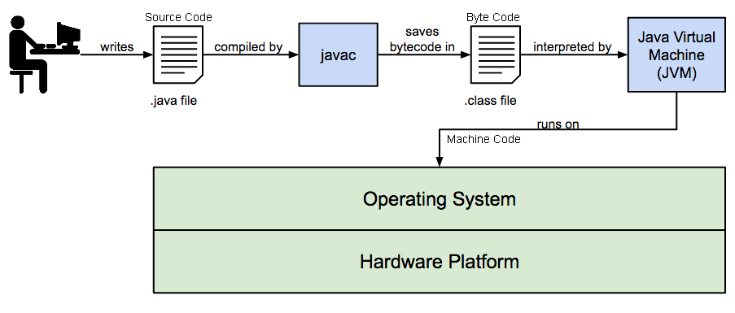
Java Architecture
Common Interview Question
Source Code - code written by humans. Stored in .java files.
Byte Code - compiled code that can be read by the JVM independent of the Operating System (Windows, Mac OS, Linux, etc.). Stored in .class files.
Machine Code - compiled code that can be read by a specific operating system. Created by the JVM when running.
Programmer writes Source Code in .java files
javac compiles the source code into Byte Code in .class files
Java Virtual Machine (JVM) interprets Byte Code into Machine Code that can be understood by the computer’s operating system.

Slide 6


JRE vs JDK
Java Runtime Environment (JRE)
Allows execution of Java applications.
Installed by default on most OSs
Contains the JVM
Does not contain libraries and tools for development
Used by home users
Java Development Kit (JDK)
Includes development library and tools
Includes the javac compiler
Includes the JRE and JVM
Used only by developers
Java Version Check
In terminal: java -version
Java JDK Version Check
In terminal: javac -version

Slide 7
Hello World!
Open Terminal
$ cd ~/source
$ mkdir HelloWorld
$ cd HelloWorld
$ code HelloWorld.java
Write the source code in the file
File -> Save
Compile the Source to Byte Code using javac
$ javac HelloWorld.java
Run the program using the JVM
$ java HelloWorld
Source Code
public class HelloWorld {
public static void main(String[] args) {
// Prints out Hello World
System.out.println(“Hello World”);
}
}
The class name, HelloWorld, must match the java file name, HelloWorld.java. Including case.

Slide 8
Parts of Hello World
Code | Description
public class HelloWorld | Java programs are made up of one or more classes which hold program code. All Java code must be in a class.
public static void main(String[] args) | The entry point to the program. When we run the program this contains the code that is executed.
{...} | Encloses a set of commands. For each opening brace there is a closing brace
// Prints out Hello World | Comment code that is not executed and provides information to the developer
System.out.println("Hello World"); | Command to write the text, Hello World, to the console. In this case the Terminal.

Slide 9
Introduction to IntelliJ
IntelliJ is an IDE (Integrated Development Environment)
Organizes code into projects
Provides immediate feedback on syntax errors
Assists in code with Intellisense
Performs many routine tasks and supplies common code snippets
Allows us to suspend a program and step through using a Debugger

Slide 10
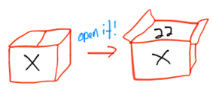
Variables
Definition Storage container paired with a symbolic name or identifier. It holds some known or unknown amount of information referred to as a value. Variables have a Data Type that defines what type of data that variable can hold.
Parts:
Data Type
Name
Value

Slide 11
Java Primitive
Data Types
Data Type | Size (Bytes) | Usage | Example
byte | 1 | whole numbers -128 to 127 | 41
char | 2 | Unicode Characters codes - representing a single letter, number, or symbols. Supports characters from most languages. | ‘a’, ‘Ф’
boolean | 1 | true / false | true
short | 2 | whole numbers -32,768 to 32,767 | -27, 10822, 1
int | 4 | positive or negative whole numbers +/- 2,147,483,647) | 12024, -500042, 1
float | 4 | floating point numbers with a precision of 7 digit | 3.14
double | 8 | double floating point numbers with a precision of 15 digits | 3.14159265358979
long | 8 | really big whole numbers +/- 9,223,372,036,854,775,807 | 5267503443, 2, -26

Slide 12
Variable Names
Rules
follow camelCase (first character lowercase after that every new word the first character is upper case)
Always start with a letter and contain numbers and letters
Can also contain or start with $ but only used by generated code
Can also contain or start with _ but discouraged
Can be any length - favor description over length
Isolation test - in isolation can you tell from the name what the variable represents
Boolean variables should start with a word that defines as a true/false question or statement ( is, has, does, etc.)
Oracle Variable Naming Documentation

Slide 13
Variable Names Continued
Bad Variable Names
name1, name2, name3
number
x
cost
Good Variable Names
numberOfStudents
averageCostOfGasInDollars
checkingAccountBalance
secondsPerMinute
totalCostInCents

Slide 14
Creating a Variable
Created in 2 Parts
Declaration - defines the Data Type and Name
int numberOfStudentsInClass;
Assignment - sets a value
numberOfStudentsInClass = 19;
Declaration and Assignment can occur as 2 lines of code:
int numberOfStudentsInClass;
numberOfStudentsInClass = 19;
Or as a single line of code:
int numberOfStudentsInClass = 19;

Slide 15
String Data Type
Holds characters “Hello world”
Can be assigned with a literal string in double quotes
String name = “John Matrix”;
Data Type name is capitalized
Can contain characters like new line, tab, and double quotes, which must identified with escape characters
\n → new line
\t → tab
\” → double quote
Example: String name = “ \”Let off some steam!\”\n\t-John Matrix”;
Prints as: “Let off some steam!” - John Matrix

Slide 16
Arithmetic Operators
Multiplicative : * (multiplication), / (division), % (modulus - returns the remainder from division)
Additive: + (addition), - (subtraction)
Assignment: = (assigns a value)
Order of Operation
Similar to PEMDAS order of operation of mathematics.
Parentheses
Multiplicative (multiplication, division, and modulus)
Addition (addition and subtraction)
Assignment
When unsure set Order of operation with Parentheses
Example:
5 + 2 * 2 results in 9
(5 + 2) * 2 results in 14

Slide 17
Float and Double Precision
Significant Digit - the point of precision when a decimal digit is “good enough” to solve the problem.
Simple Explanation
Modern 64bit computers can store 56 significant digits, but this is the number of digits in binary and not base-10 Arabic Numbers! Decimals are also stored in scientific notation and float and double don’t understand recursive numbers (ones with repeating digits like 10 / 3 == 3.3333333333~. This often causes rounding errors when doing math with floating point numbers.
Often we don’t care because the significant digit is small enough not to matter. For example, if 10/3 then an answer of 3.33 may be “good enough”, but what if we care about absolute precision like in a currency or a scientific calculation?
A more detailed explanation can be seen in this short Video

Slide 18
Type Conversion
Literal numbers in Java have a default data type. All whole number literals default to int, and all floating point numbers default to double.
For example, float x = 2.0; will result in an error, since 2.0 defaults to a double.
There are shorthand casting available for literal numbers. L tells Java you want the literal to be a long and F tells Java to treat the number as a float.
float x = 2.0F;
long y = 1000L;
The Problem: Data types are different sizes. For example, a long type can hold a very large number, but int can only hold a number approximately 2.1billion in size. If we have a long x that contains a 10, then we know it will fit in an int, but how do we use it as an int?
Solution: Casting allows us to tell Java to treat a variable as a different data type, provided they both hold the same type of data. To cast the type we want Java to treat the data as is added before it in parentheses.
long x = 10; int y = (int) x;

Slide 19
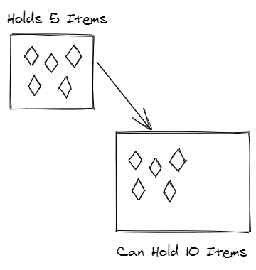
Widening
Cast (converting) from a smaller data type into a larger data type
int → long float → double
Implicitly Cast (converted (cast) automatically)
int x = 10;
long y = x;

Slide 20
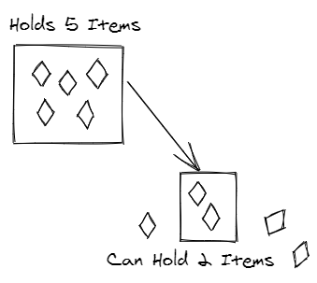
Narrowing
Cast (converting) from a larger data type into a smaller data type
long → int double → float int → short
Explicitly Cast (not automatic and code must indicate that it should happen and the data type to convert (cast) it to )
long x = 10;
int y = (int) x;

Slide 21
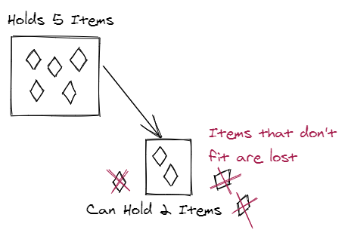
Truncation
When a narrowed value doesn’t “fit” into the new data type, the “extra” is ignored.
double x = 5 / 2; ( double = int / int)
5 / 2 = double 2.5 → int 2

